Slide 1
Machine learning for medical Imaging
SUMMARIZED BY PETER CARRAS

Slide 2
Machine Learning vs Deep Learning
Machine Learning
Deep Learning
A type of artificial intelligence
Teaches computers how to learn to do a task instead of telling the computer explicitly how to do that task
A type of machine learning
Uses artificial neural networks based on the structure of neurons from the human brain
Deep refers to having many layers in your neural network

Slide 3
Convolutional Neural Networks
CNNs assume that inputs have a geometric shape like the rows and columns of pixels in an image
Layers are organized into 3 dimensions, width, height, and depth
Final output is reduced to a single vector of probability scores organized along the depth dimension
Input layer has neurons arranged to produce a convolution of a small image
Convolution: mathematical combination of two functions to produce a third function i.e. it merges to sets of information
Features are found by the algorithm not by the user

Slide 4
Important Terms
Classification: Assigning a label to a group of pixels or a piece of data
Model: The resulting weights or decision tree learned by through machine learning.
Algorithm: A series of steps taken to create a model
Labeled Data: A set of examples that have already been labeled
Training: The phase in which the algorithm is a validation set and learning occurs through modifying the weights or decision points to improve accuracy
Validation/Training set: The set of examples used during training
Testing: Data that the algorithm has never seen before in the training set is used to see how well your algorithm may work in a real world scenario

Slide 5
More Terms
Node: A element of a neural network that takes two or more inputs and an activation function and decides on an output
Layer: A collection of nodes that compute outputs from previous layers or from the data
Weights: The value multiplied by the input feature to help determine when a node should be activated

Slide 6
Types of Machine Learning
Supervised
Uses labeled data
Good for classification or categorization
Can overfit data
Unsupervised
Unlabeled data
Good at clustering data
Gives structure to data without labels
Reinforcement
Learns through rewards and penalties
Tries to maximize rewards
Ex. Meta MarIO getting coins and smashing Goombas

Slide 7
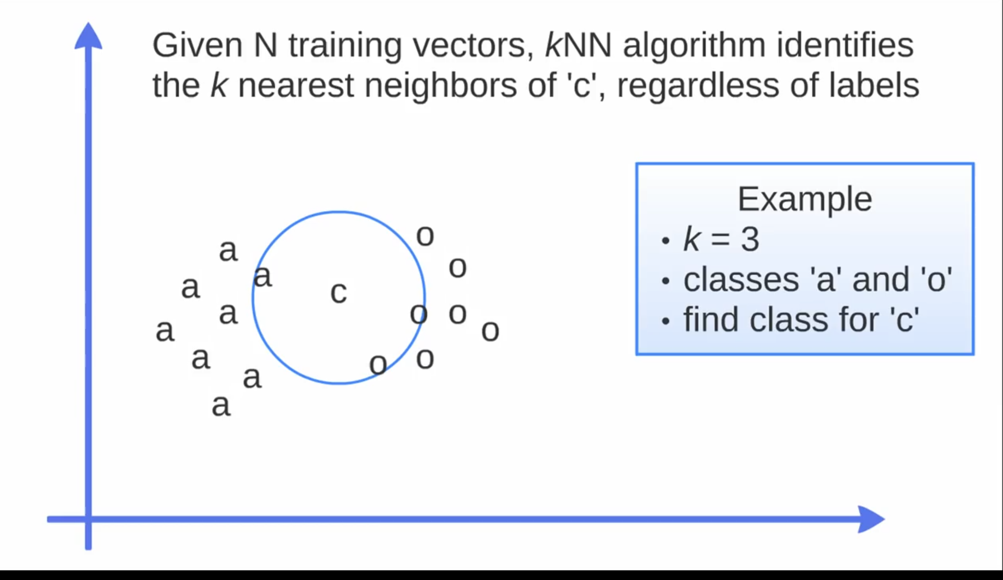
K-Nearest Neighbors
Given the classes a and o we can find the class of c by taking the k nearest neighbors. In the example shown this is 3
There are 2 o elements and only 1 a element so we can conclude that the class of c is o
As a result we would rewrite c as o

Slide 8
Support Vector Machines
Support vector machines find the hyper-plane that separates training data that maximizes distance between the hyper plane and the closest points from each class.
They can be used when you have very little data and relatively high number of features
Support vector machines classify data and do not give any information about the probability it is in one class or anoter

Slide 9
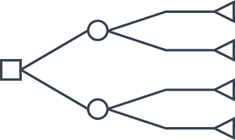
Decision Trees
Decision trees are built using recursive binary splitting that picks the question/features that maximizes accuracy
Decision trees provide quantifiers that we can interpret as humans

Slide 10
Naïve Bayes Algorithm
Naïve Bayes Classifier assumes the presence of a particular feature in a class is unrelated to the presence of any other feature, this is why it is referred to as naïve
Calculates posterior probability equation to determine the probability of an outcome
P(y|x) = [P(y) * P(x|y)]/P(x)
Probability P(y) given x equals the probability of y times the probability of x given y divided by the probability of x
Note that the probabilities are not accurate and you should instead look only at the highest probability outcomes
Used mostly to classify text and with problems that have multiple classes

